Slide 1




Big Data Analytics Project
TEAM GREEN : PHASE-2

Slide 2

Requirements
Case 1
Extract your 60,000 random sample records from Hive and download it to your local device
Case 2
Combine your file with the other sample year files from your other team members
Case 3
Train, validate and test the analytics model
Conclusion
Using best prediction model, predict on the 10 given samples

Slide 3

SARAH ANNIE GEORGE
Year – 2005
Operating System: MAC

Slide 4


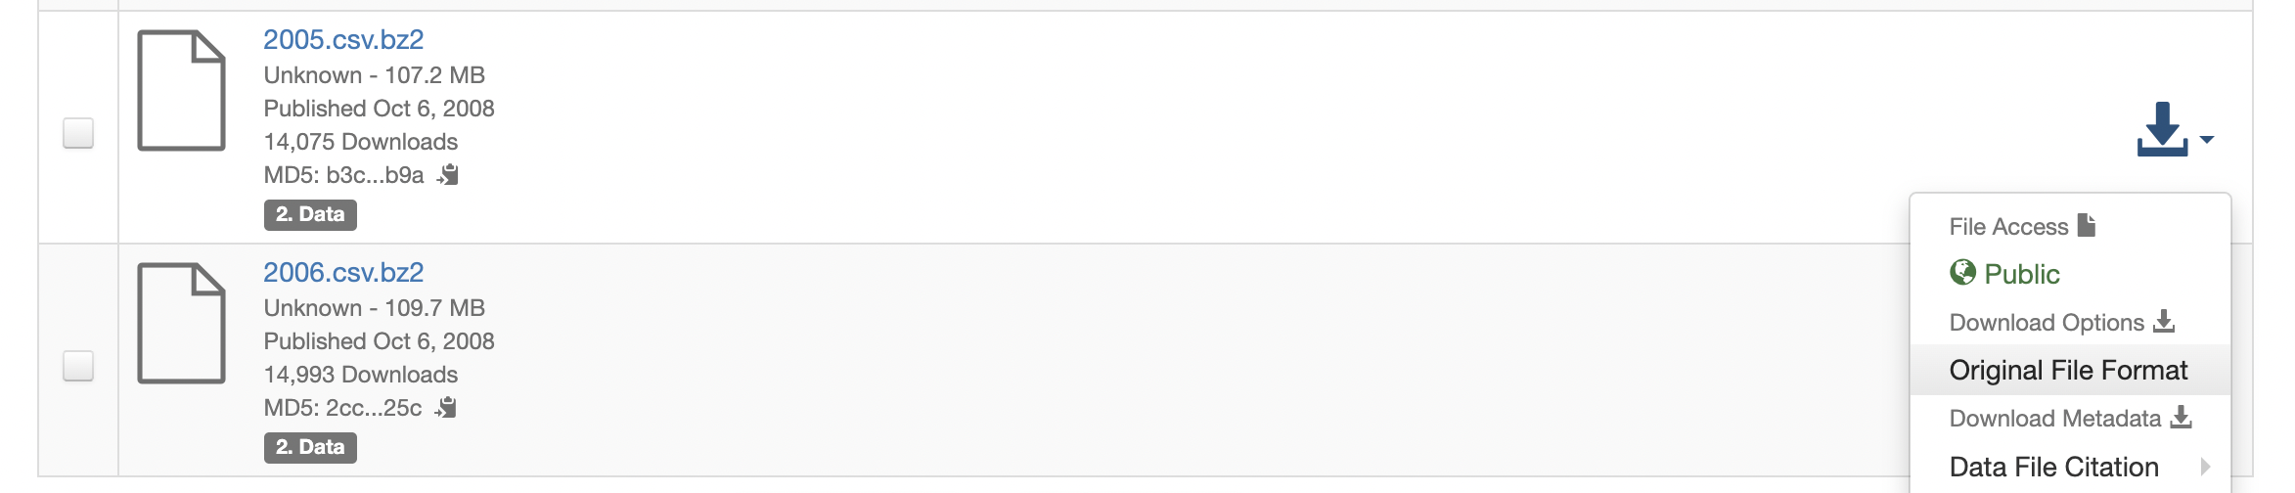
SARAH ANNIE GEORGE Data source
Airline On Time Data
The data represents flight arrival and departure details for all commercial flights within the USA for the year 2005
Download Link -
Harvard - Airline On Time Data
2005 data: Used ”The Unarchiver” s/w to unzip .bz2 file format

Slide 5
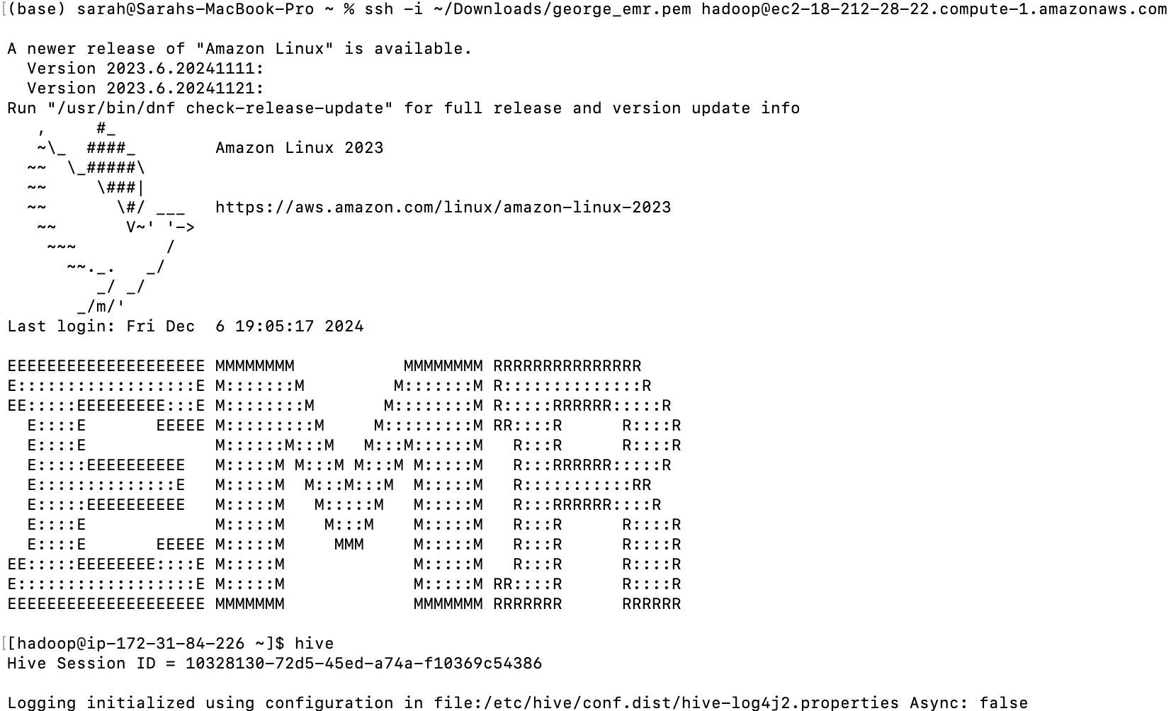
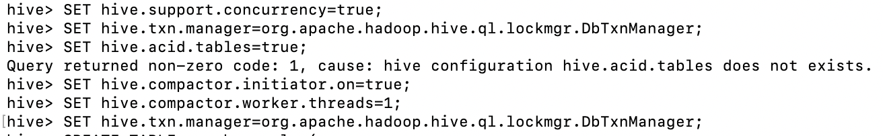
SARAH ANNIE GEORGE HIVE TABLE CREATION Create a new table in Hive using the format of your year table. Name it “sample” with your name
Step 1: Connect to hive
Step 2: Enable ACID Support in Hive CLI.
NOTE: Hive only supports UPDATE and DELETE operations on tables stored in formats like ORC or Parquet that support ACID (atomicity, consistency, isolation, and durability) transactions.

Slide 6
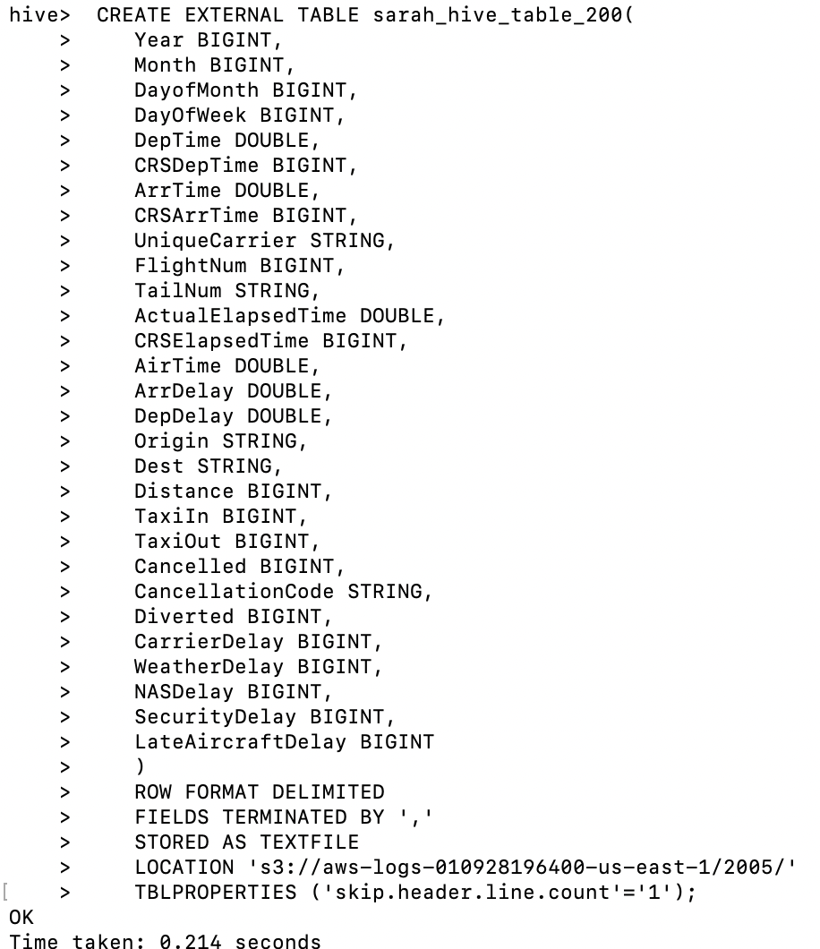
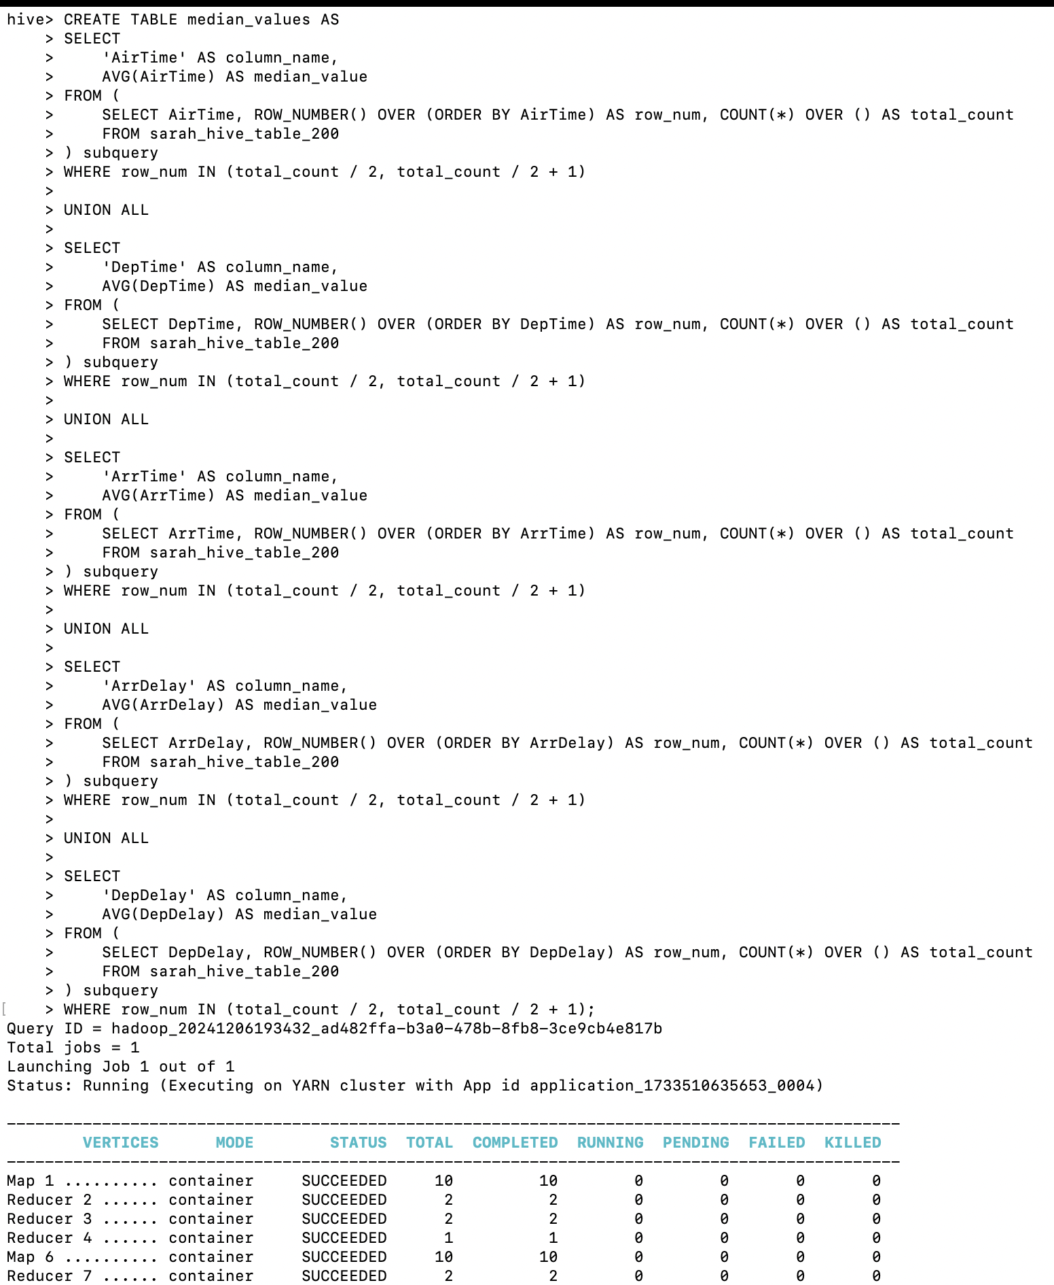
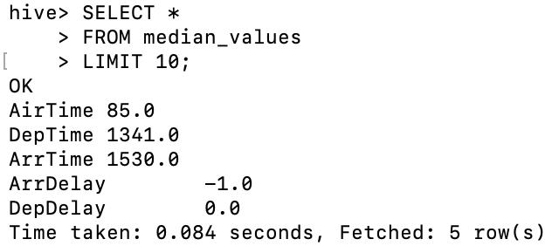
SARAH ANNIE GEORGE HIVE TABLE CREATION Create a new table in Hive using the format of your year table. Name it “sample” with your name
Step 3: Create a temporary table with all 2005 csv data
Step 4: Create 2005 table & insert values from temporary table to the 2005 table & whilst doing that replace nulls with median for numerical cols as below by first creating a median table

Slide 7
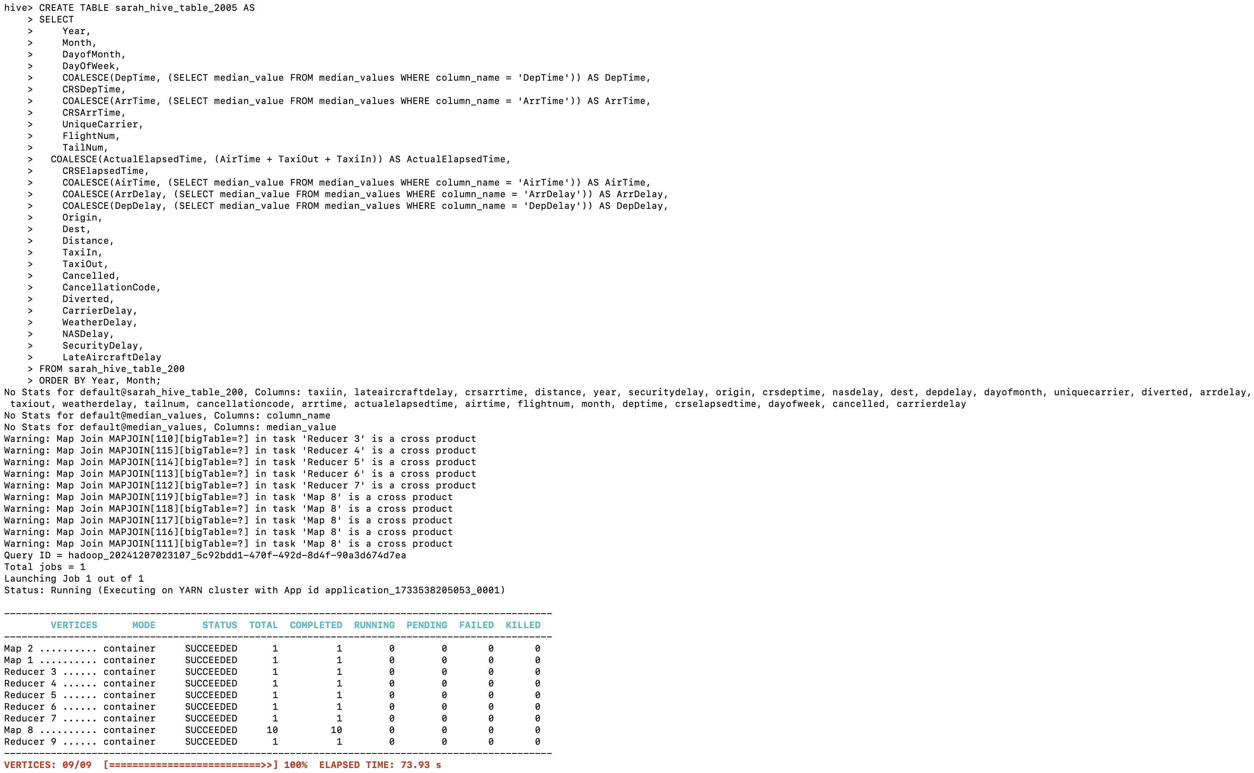
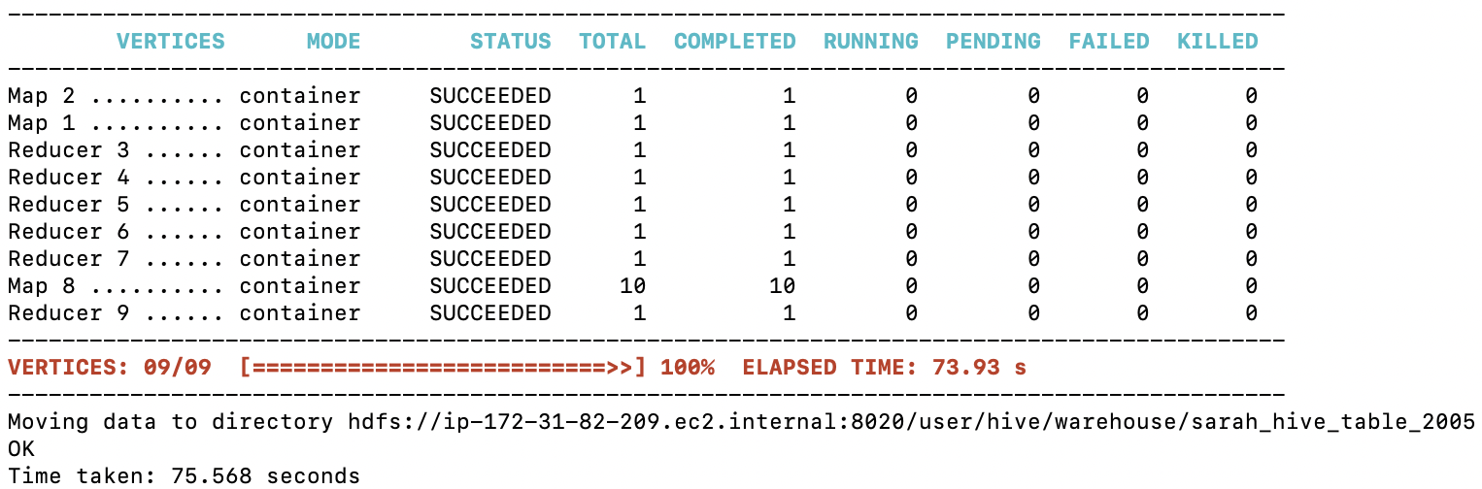
SARAH ANNIE GEORGE HIVE TABLE CREATION Create a new table in Hive using the format of your year table. Name it “sample” with your name
Step 6: Create 2005 table & insert values from temporary table to the 2005 table & whilst doing that replace nulls with median for numerical cols as below by first creating a median table

Slide 8
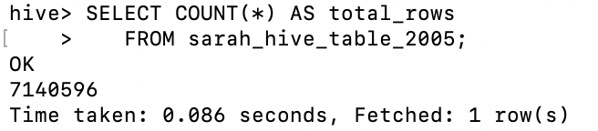
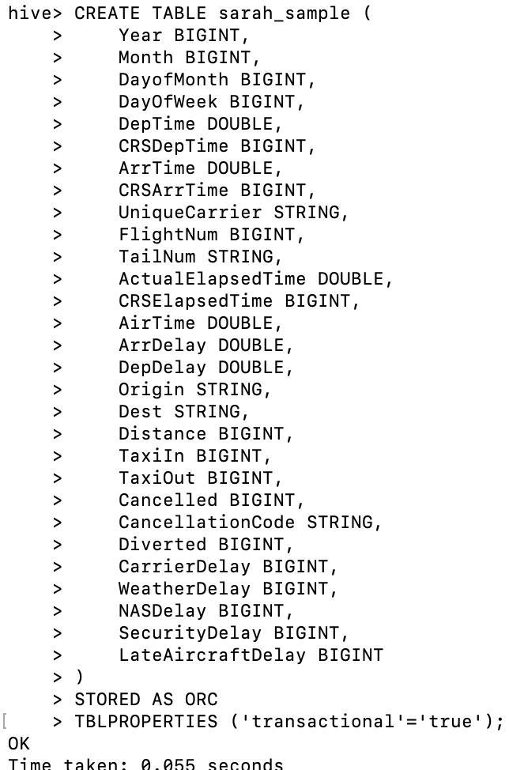
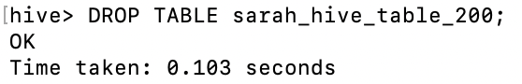
SARAH ANNIE GEORGE HIVE TABLE CREATION Create a new table in Hive using the format of your year table. Name it “sample” with your name
Step 7: See count of data in 2005 table
Step 8: Create new table named sarah_sample with same fields of 2005 table
Step 9: Drop the temporary table

Slide 9
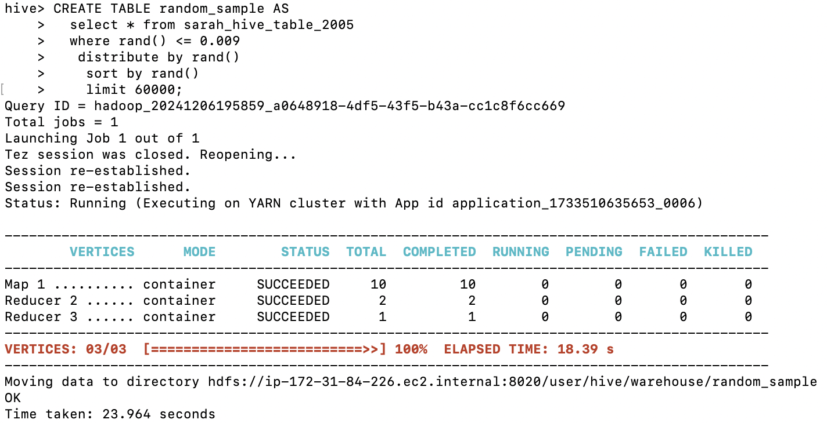
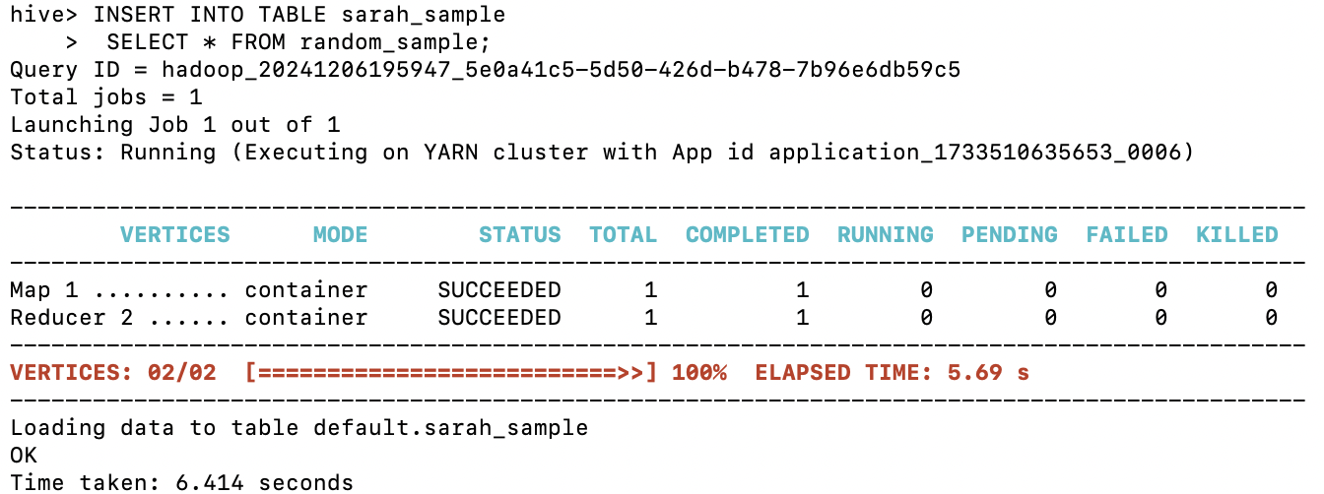
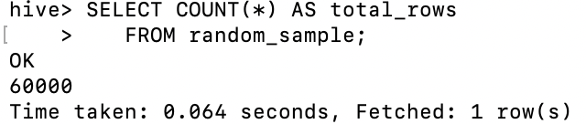
SARAH ANNIE GEORGE RANDOM SAMPLE SELECTION Select a random sample of 60,000 records from your year table & Load into sarah_sample table
Step 1: Select 60k records and save in a table
Step 2: Insert randomnly selected 60k samples into sarah_sample

Slide 10
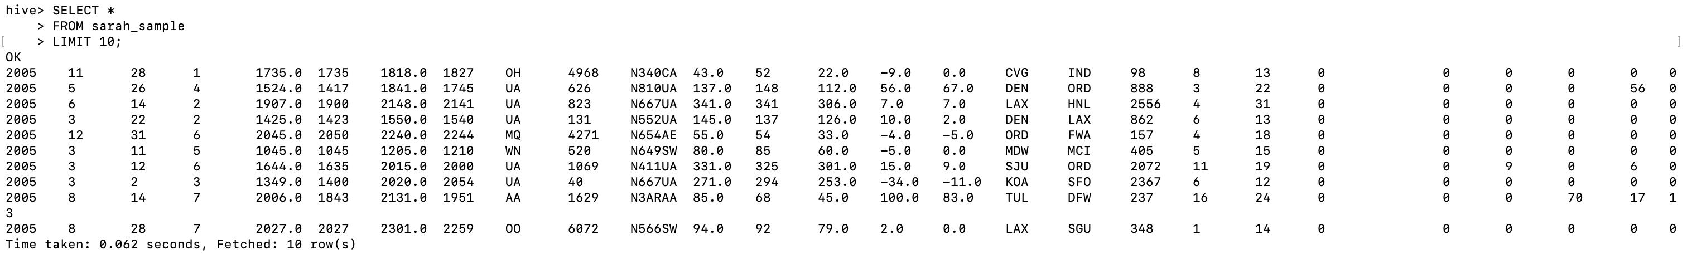
SARAH ANNIE GEORGE RANDOM SAMPLE SELECTION Select a random sample of 60,000 records from your year table & Load into sarah_sample table
Step 3: See 60k random data in sarah_sample

Slide 11
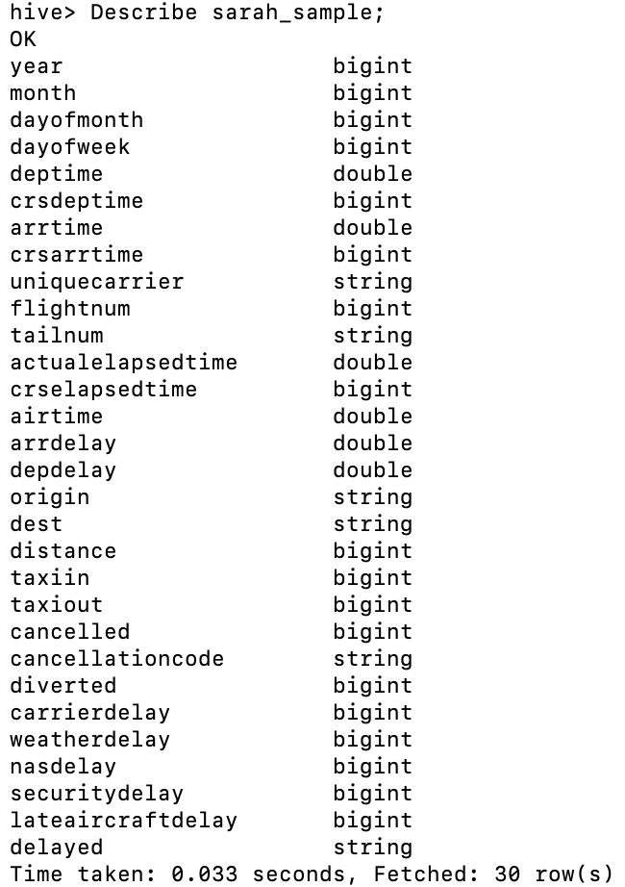
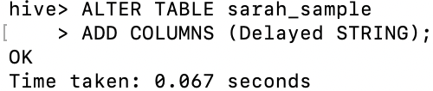
SARAH ANNIE GEORGE NEW COLUMN ADDITION Add a new column “Delayed” to the sarah_sample table
Step 1:Add delayed column
Step 2:see delayed col added

Slide 12
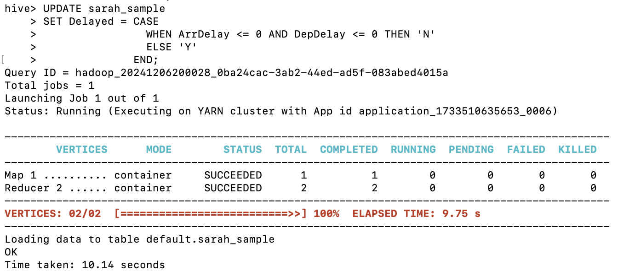
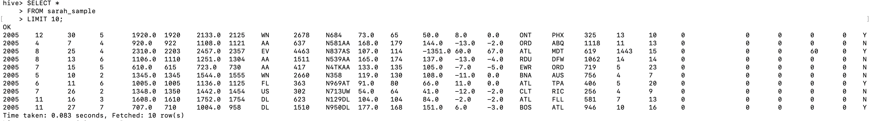
SARAH ANNIE GEORGE NEW COLUMN ADDITION Populate the Delayed column with Y/N (If ArrDelay & DepDelay <= 0 then N else Y)

Slide 13
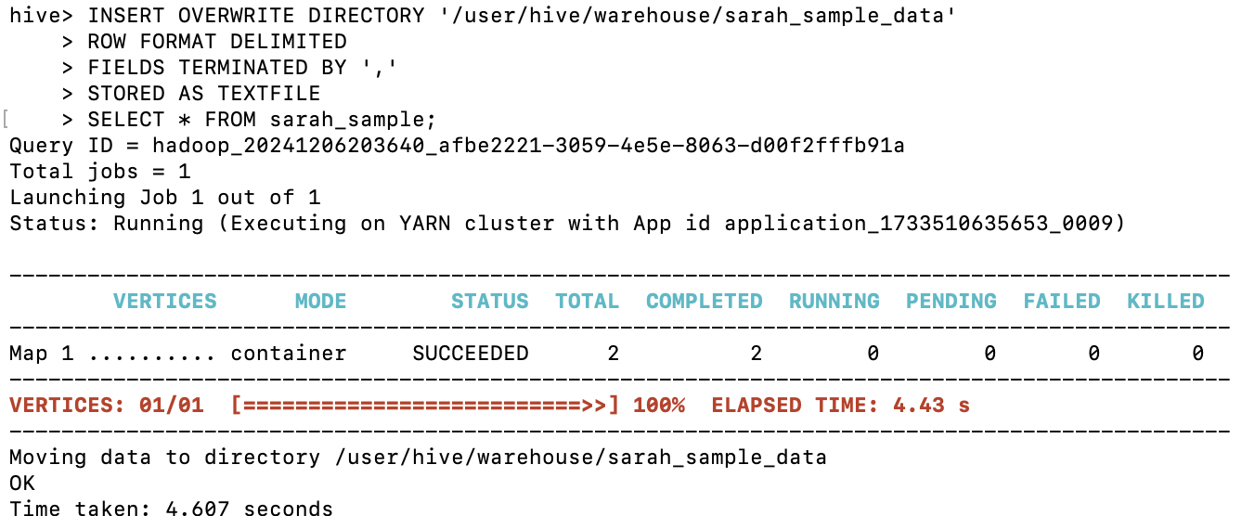
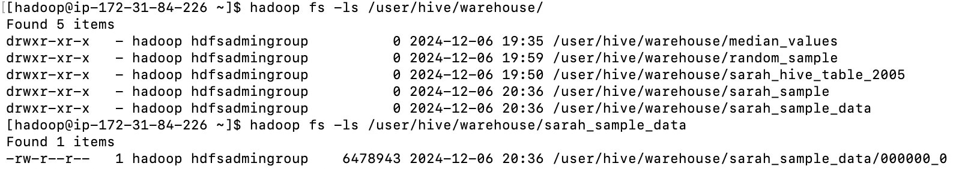
SARAH ANNIE GEORGE DOWNLOAD TO LOCAL DEVICE Extract your 60,000 sample records from Hive and download it to your local device.
Step 1: export from hive to hadoop directory by saving as csv with comma delimiter
Step 2: check if the file I stored in Hadoop directory exists

Slide 14
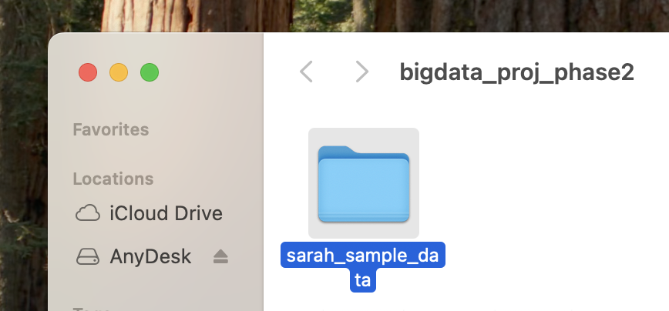
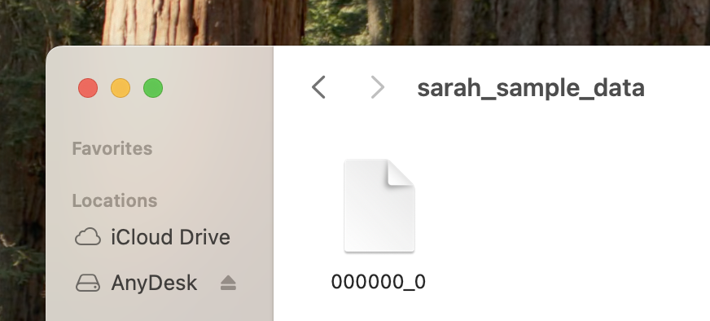
SARAH ANNIE GEORGE DOWNLOAD TO LOCAL DEVICE Extract your 60,000 sample records from Hive and download it to your local device.
Step 3: save sample data file in hadoop local directory
Step 5: 60k file saved on my desktop
Step 4: save to my Desktop using – (scp -i ~/Downloads/george_emr.pem -r hadoop@ec2-18-205-163-133.compute-1.amazonaws.com:/home/hadoop/sarah_sample_data /Users/sarah/Desktop/bigdata_proj_phase2)

Slide 15
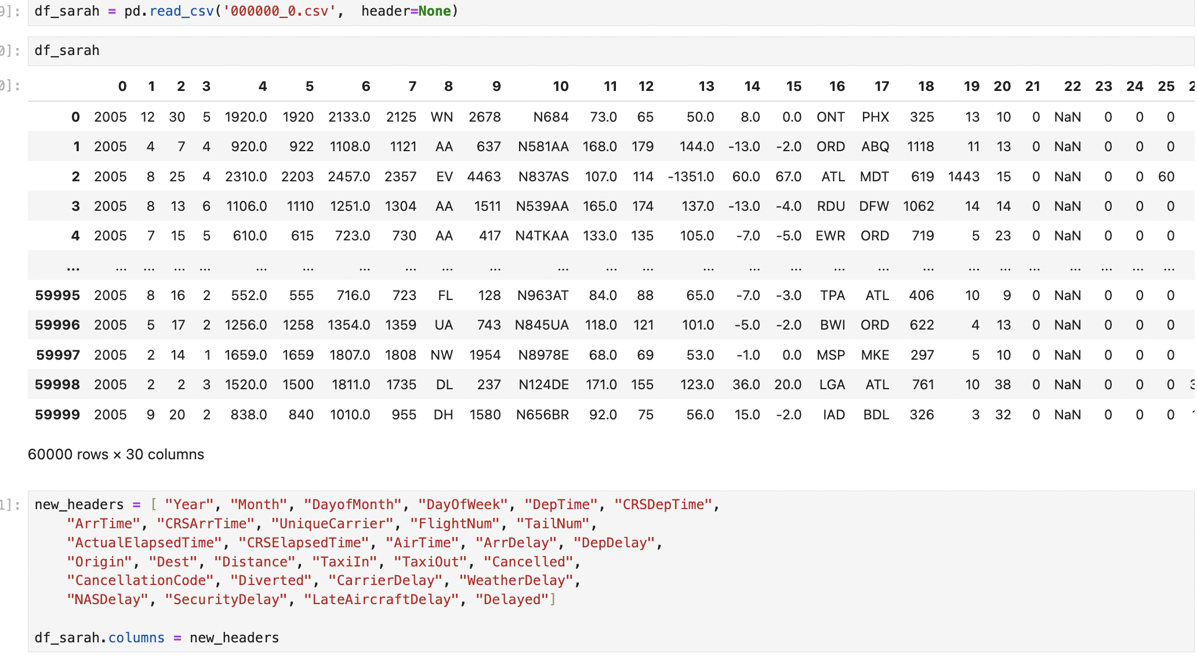
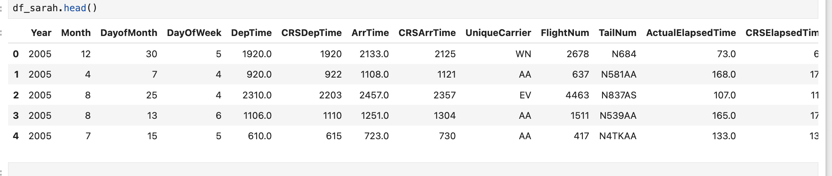
SARAH ANNIE GEORGE COMBINING YEAR TABLES Combine your file with the other sample year files from your other team members .
Step 1: Since I removed headers in hive, Readding headers in my file through Python
Step 2:See my file with headers

Slide 16
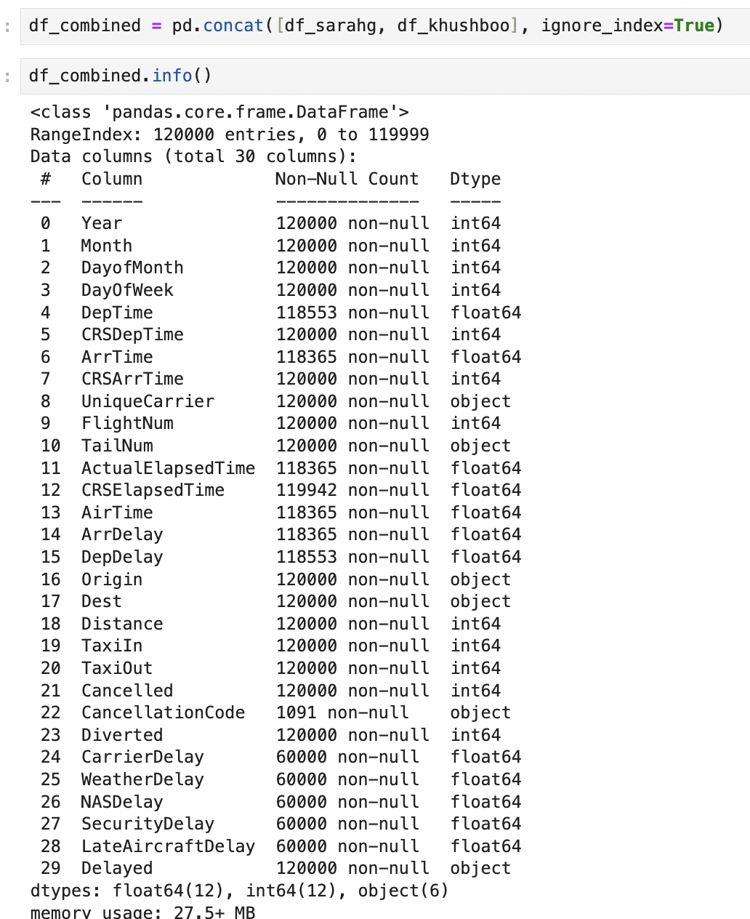
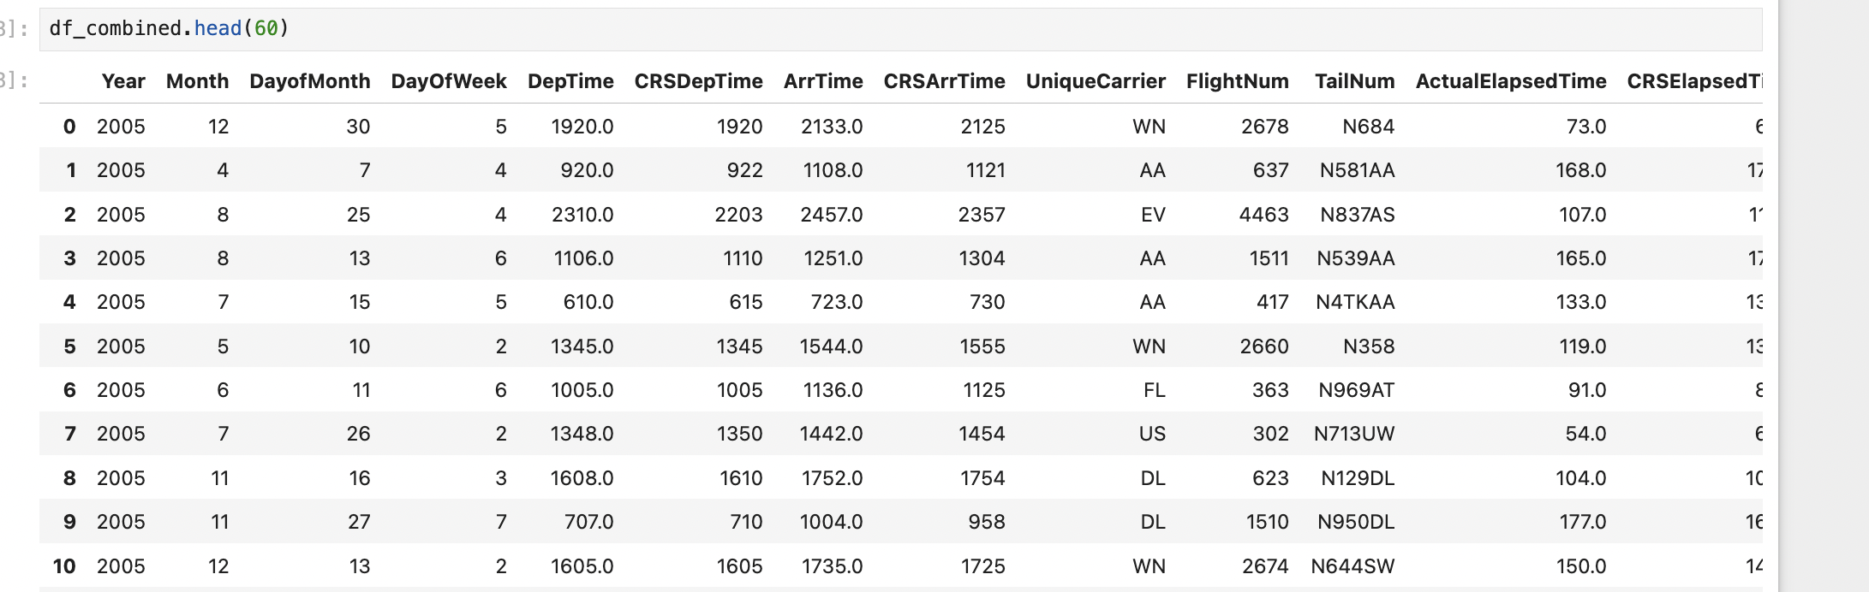
SARAH ANNIE GEORGE COMBINING TABLE Combine your file with the other sample year files from your other team members .
Step 3: Combine with my team members file(2005 & 1996)
Step 4:See combined file of 120000 records

Slide 17
SARAH ANNIE GEORGE CHOOSE MODEL
Individual Model Chosen: Random Forest Model (using Python)
Why: because it handles mixed data types (numerical and categorical), captures nonlinear relationships, and is robust to outliers and noise

Slide 18
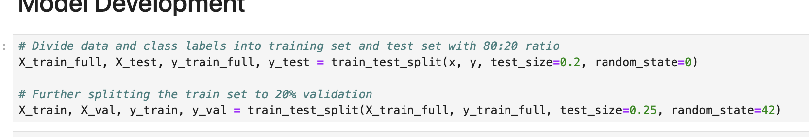
SARAH ANNIE GEORGE TRAIN,TEST & VALIDATED COMBINED SAMPLE
Split train & test data for further training : 60:20:20 (train,val,test)

Slide 19
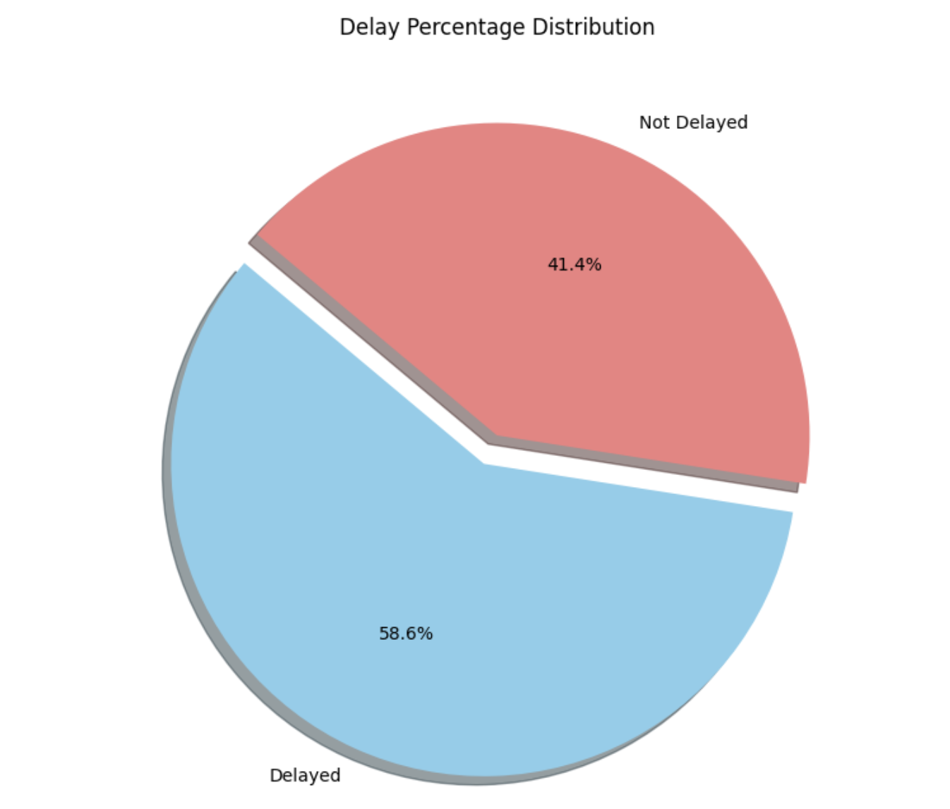
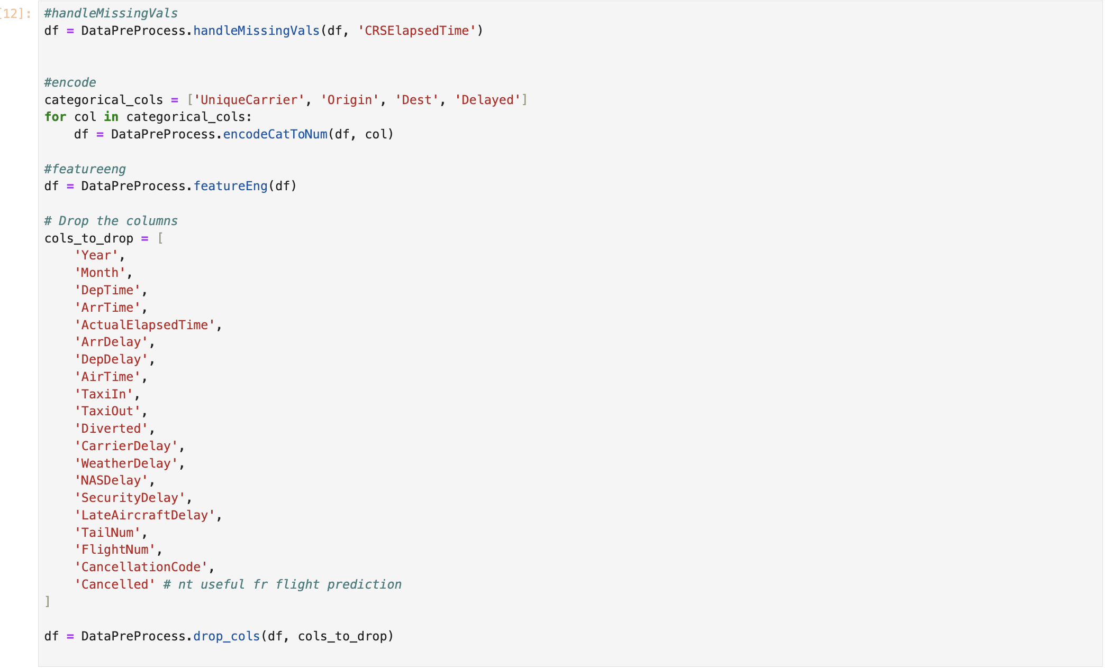
SARAH ANNIE GEORGE TRAIN,TEST & VALIDATED COMBINED SAMPLE
Step 1: Data Preprocessing
Handle missing values
Encode categorical to numerical
Drop cols which are not in our test dataset and also dropped cols like year, talinum, flightnum, cancellationcode which are unique codes or numbers & will not help in our analysis
Initially, let’s see the percentage of delayed & not delayed in our combined dataset(120000 records)
Columns like Arrdelay & Depdelay will give us high accuracy but they are not in test dataset & also when I got an accuracy of 99% using those values it was overfitting.

Slide 20
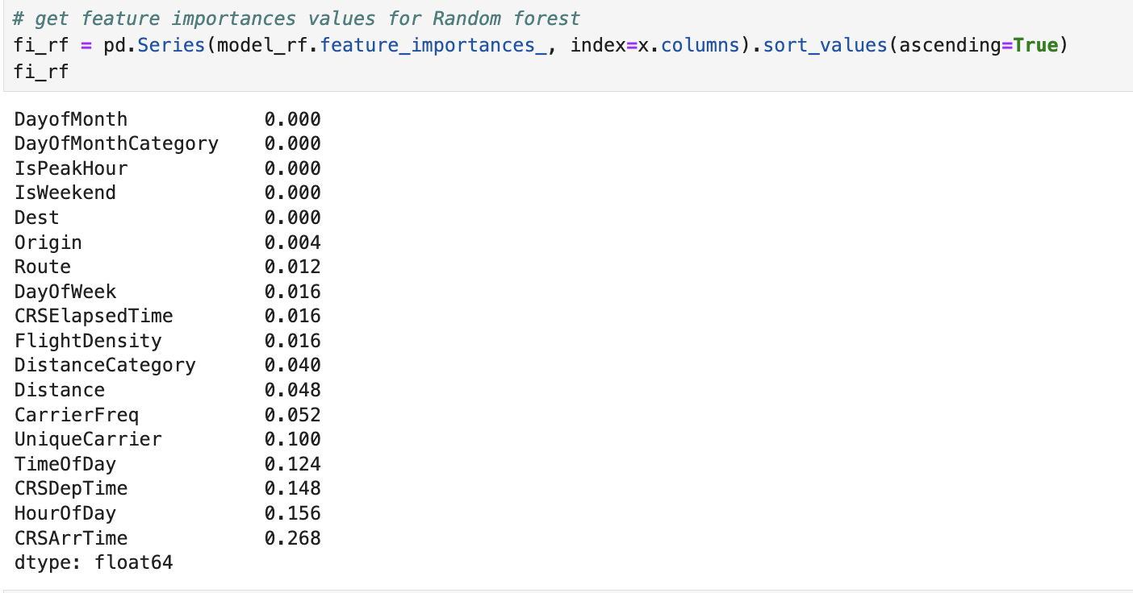
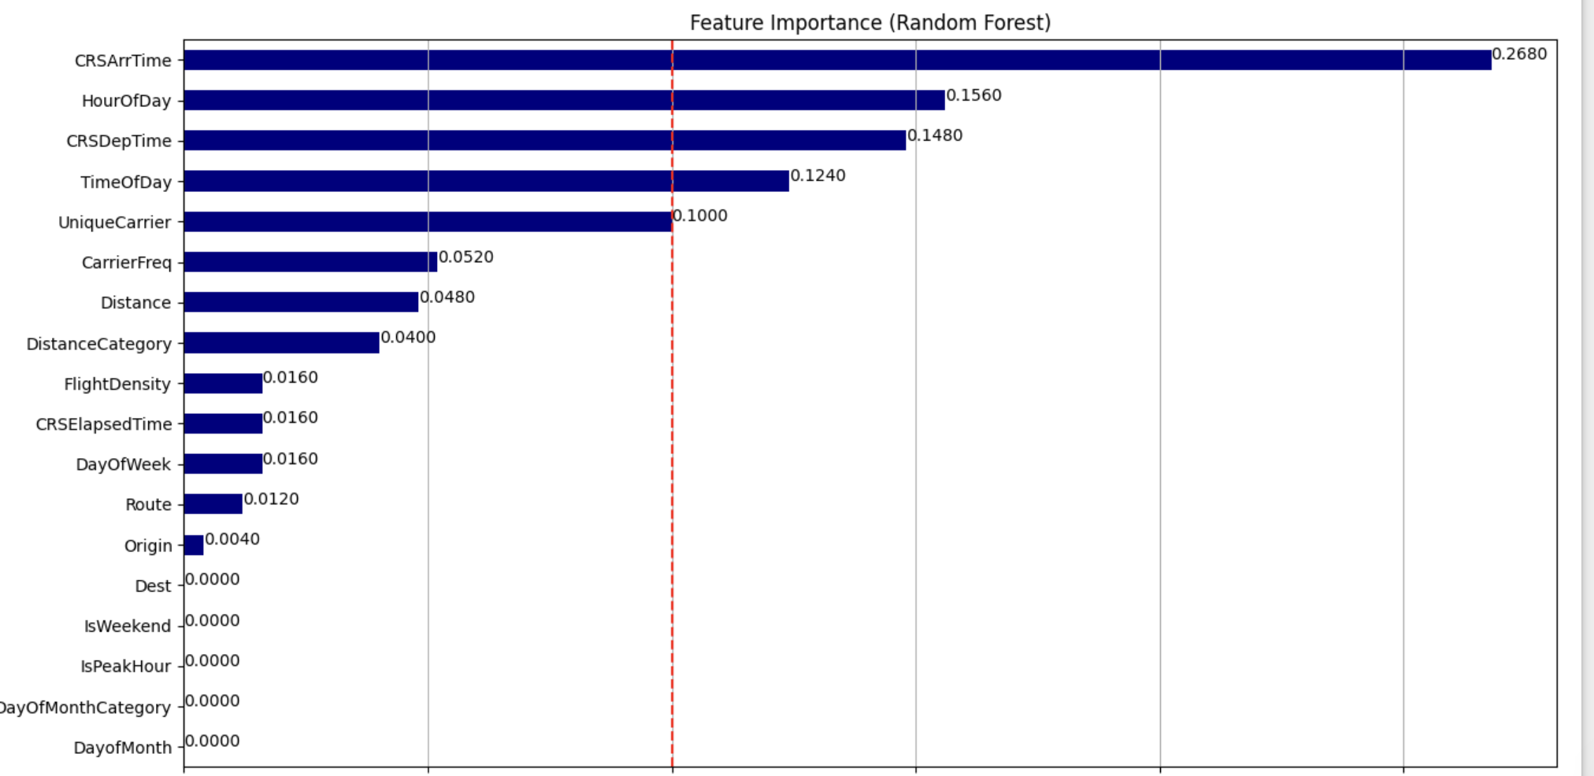
SARAH ANNIE GEORGE TRAIN,TEST & VALIDATED COMBINED SAMPLE
Step 4: Added new features that made sense to help in predictions like – HourOfDay, ispeakhour & more, checked feature importance. I have used all these below features for training my model

Slide 21
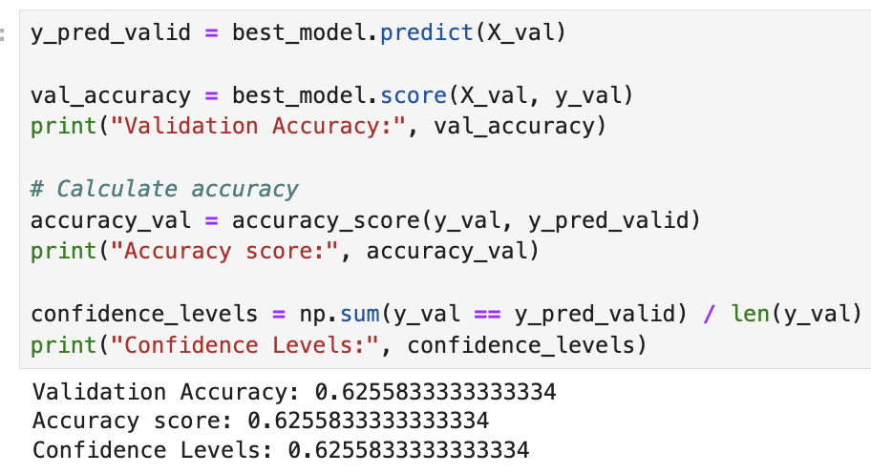
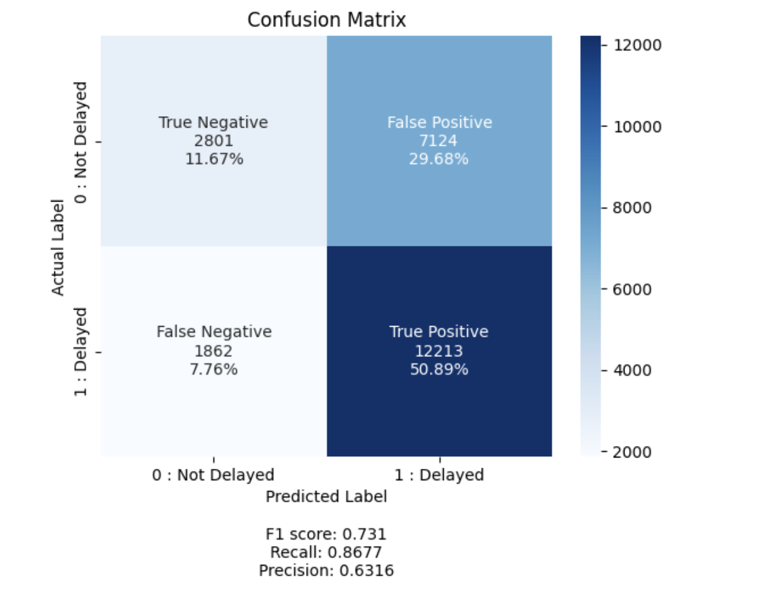
SARAH ANNIE GEORGE TRAIN,TEST & VALIDATED COMBINED SAMPLE
Step 5: Accuracy & Precision
Conclusion:
1)Accuracy: 62.55% , Precision: 63.16%, F1 score: 73.1%, Recall: 86.77%
My accuracy & precision suggest that there is room for improvement in overall predictive performance. My recall shows that it is good at capturing true positives. My F1 score suggests that the model is relatively balanced but leans toward prioritizing recall over precision.

Slide 22
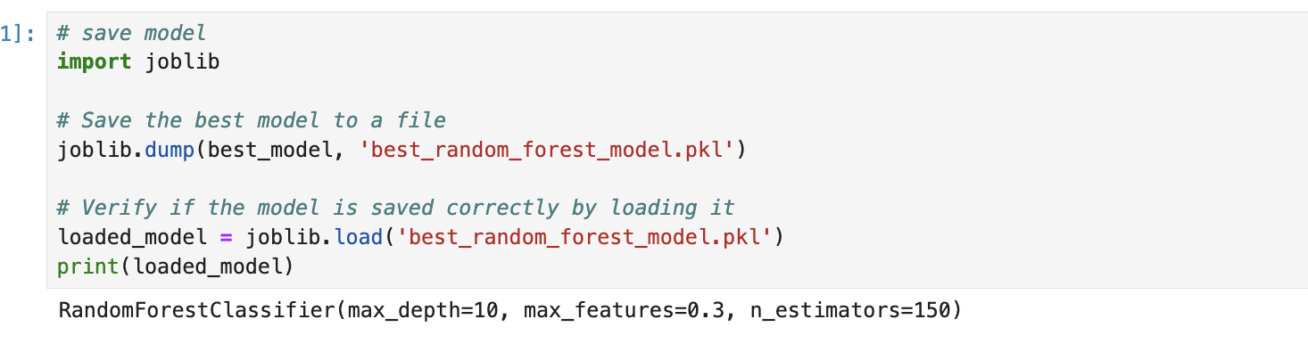

SARAH ANNIE GEORGE CREATED A PICKL FILE TO SHARE MY MODEL WITH TEAM

Slide 23
SARAH ANNIE GEORGE CHOOSE ANOTHER MODEL
Performed this individually due to no results from team
Model Chosen By Team:Gradient Boosting Models
Why: because they handle complex, nonlinear relationships between features and optimize performance by reducing bias and variance. They are highly flexible, work well with imbalanced datasets, and often outperform simpler models like Random Forest.

Slide 24
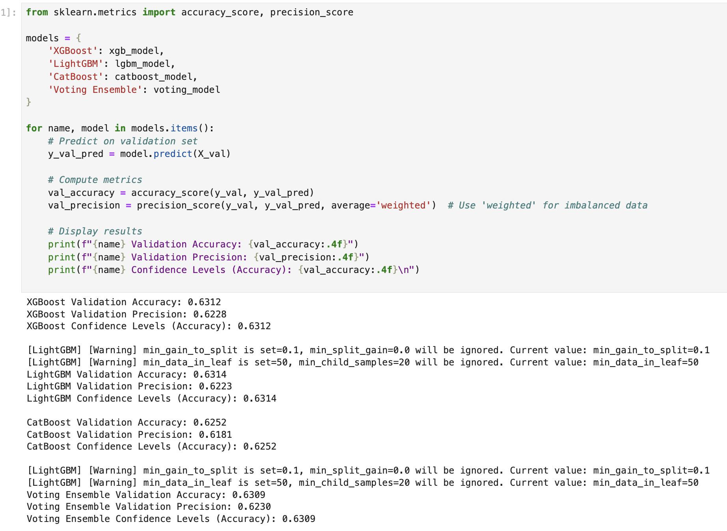
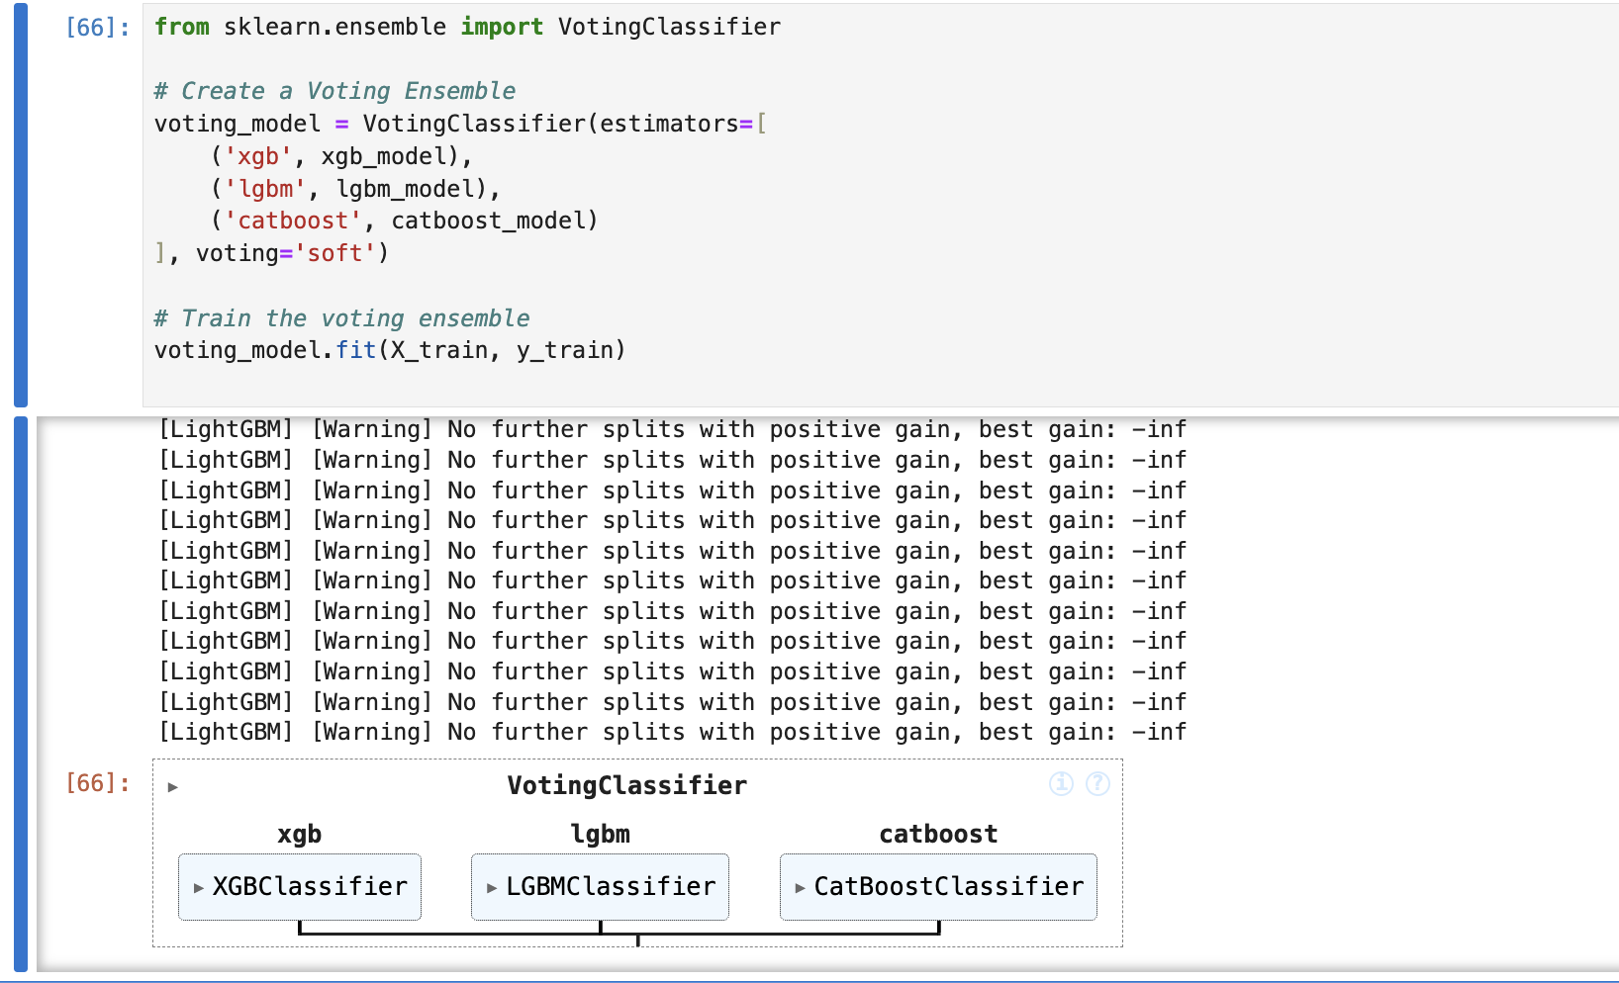
SARAH ANNIE GEORGE ACCURACY & PRECISION
Data Preprocessing steps same as before
Step 1: The individual models (e.g., XGBoost, LightGBM, and CatBoost) are trained on the same dataset. The Voting Ensemble combines the predictions of the base models(soft voting) - Each model provides probabilities for each class. The ensemble averages these probabilities and selects the class with the highest average probability as the final prediction.
Conclusion: By combining the strengths of multiple models, voting ensembles reduce bias and variance, leading to better overall performance. The Voting Ensemble provides the most balanced performance with high precision(62.30%) and comparable accuracy(63.09%). If we prioritize accuracy, we could also consider LightGBM, as its accuracy is marginally higher.

Slide 25

Team Conclusion Slides

Slide 26
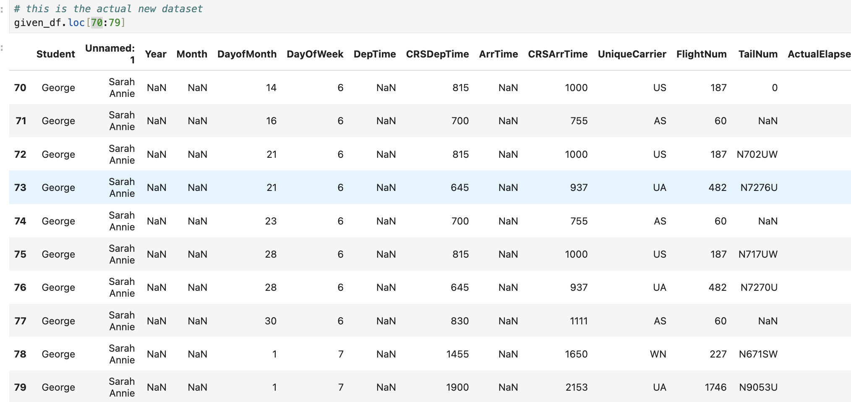
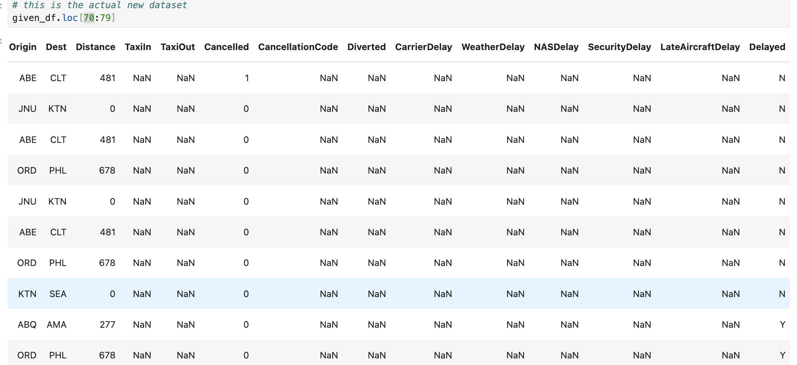
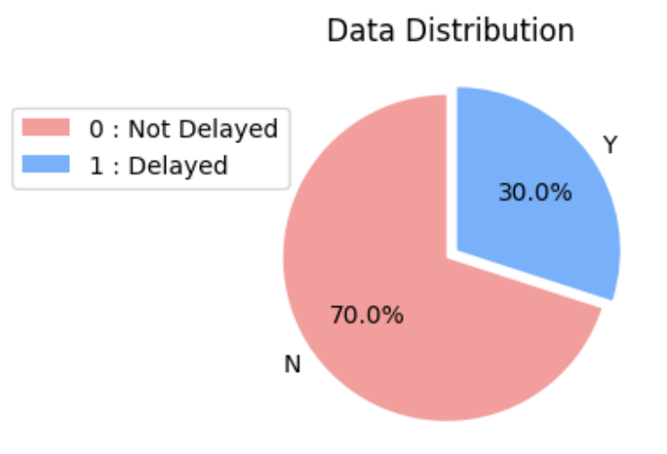
SARAH ANNIE GEORGE USING THE BEST MODEL TO PREDICT 10 SAMPLES – USING RANDOMFOREST
Conclusion: Currently, none of the models meets 90% precision and accuracy. Based on the results:
Precision:
Random Forest has the highest precision (63.16%) among the models.
Accuracy:
LightGBM achieves the highest validation accuracy (63.14%).

Slide 27
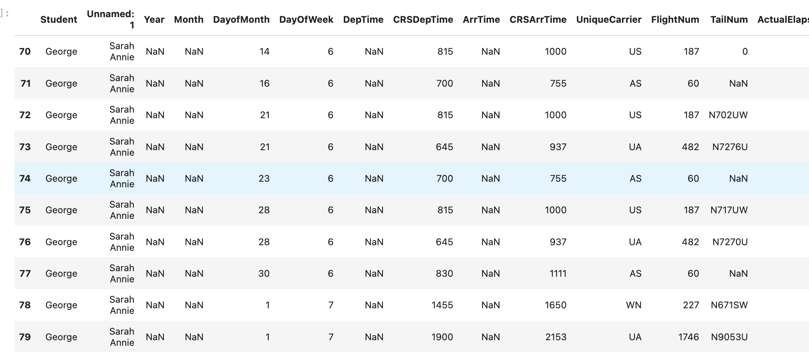
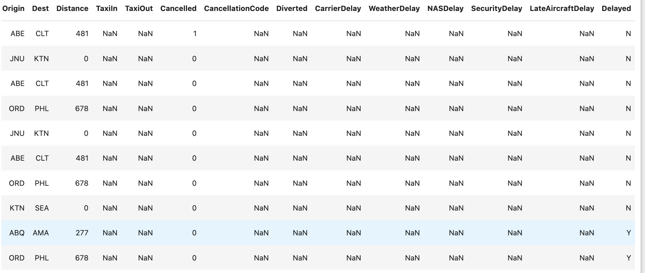
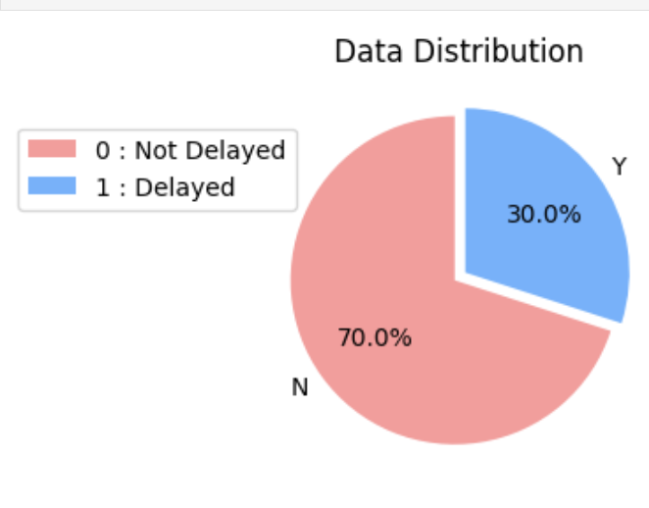
SARAH ANNIE GEORGE USING THE BEST MODEL TO PREDICT 10 SAMPLES – USING LIGHTGBM(BETTER CHOICE)
CONCLUSION: Since the differences are small, LightGBM might be the better choice for general use as it balances precision and accuracy effectively.

Slide 28

Further Improvements:
To improve further and aim for 90%:
Focus on improving feature engineering and tuning hyperparameters.
Using smote to balance classes but difference was not that big. I tried and it did not make much difference
Some relevant and predictive features which will help in prediction were missing in test set so was difficult to get good prediction & accuracy, if we had at least 1 important feature like actual arrival time then we could get better predictions. Adding just one highly relevant feature (like actual arrival time) could make a significant difference, as it would directly influence the target variable (Delayed or Not).

Slide 29



